Slide 1
Quality Assessment and Communicating Student Learning
Part 10
Notes:
Welcome to part 1 of the Quality Assessment and communicating student learning series.
This series of videos has been designed to support teachers with quality assessment and communicating student learning with families and caregivers. Throughout the videos you will be given information and time to pause, reflect and discuss in table talk conversations. Each module also comes with resources that will support the learning. We acknowledge that the way that teachers assess and communicate student learning is unique to each of their practices, what we will be sharing in these modules are best practices based on research as well as ministry and district requirements.

Slide 2
Included in Part 10
Reporting
Strength Based Descriptive Feedback
Standards based gradebooks – MyEd and Spaces
Notes:
Included in part 1:
The 'why' - What does the research say?
The CSL window
The essential elements of quality assessment and communicating student learning (CSL)
Triangulation of evidence of learning

Slide 3
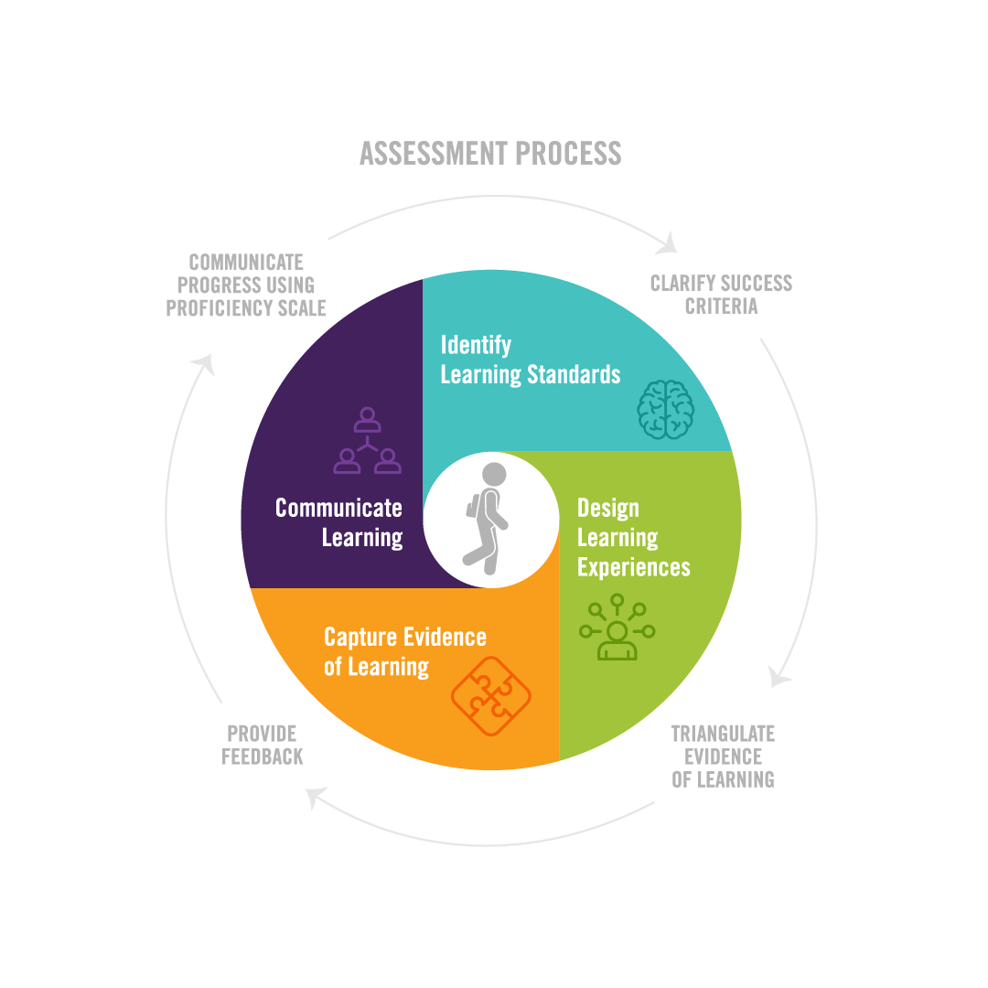
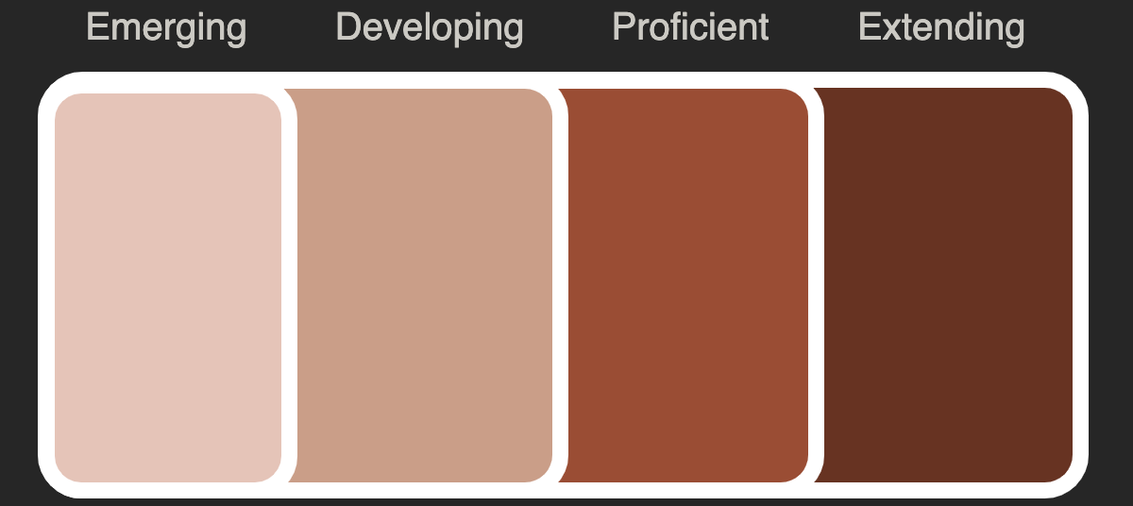
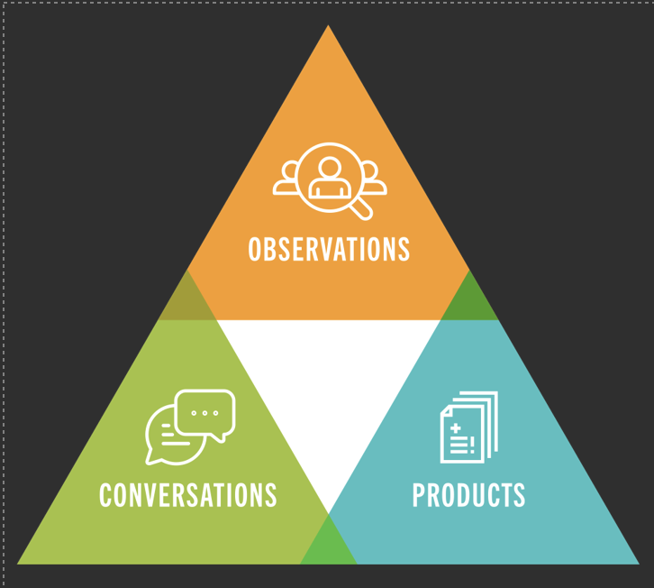
TRACKING PROGRESS AND REPORTING
/CREATE PROFICIENCY SCALES
& REPORTING
C
T
PS
STRENGTH-BASED DESCRIPTIVE
Notes:
Once teachers design multiple modes and opportunities for students to demonstrate evidence of learning, that evidence must then be gathered and captured in some way. A digital portfolio can be a dynamic platform to capture multi modes of assessment, such as audio recordings, visual representations, written responses, etc. Some teachers may use proficiency scales with a space for recording evidence, while others may use a standards based gradebook or proficiency tracker as a means to track progress, growth and evidence of learning.
With clearly defined learning goals/standards, and clarified proficiency scales, our hope is that students are able to use the criteria to accurately self and peer assess, and become more assessment capable.

Slide 4
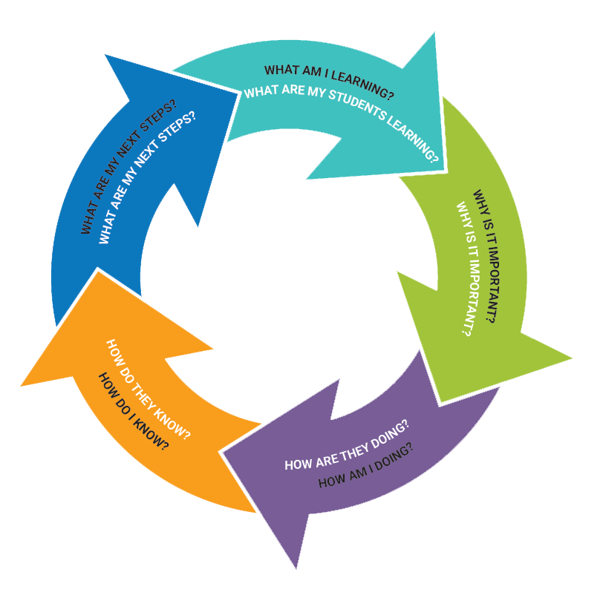
& REPORTING
/CREATE PROFICIENCY SCALES
Notes:
When the learning and assessment process is aligned, fair, transparent and equitable, students should be able to respond to the following questions that engage them deeper in the learning process:
And at the same time the teacher is also engaging in the same process.
what are my students learning?
why is it important?
How are my students doing?
How do I know? How do they know?
What are their next steps?/what are my next steps?

Slide 5
Descriptive Feedback
Most effective when it is clear, concise, and written in accessible language
Connected to the learning standards/goals of the curriculum
Strength Based, identifying what the student KNOWS and can DO
Provide next steps for growth and improvement
Notes:
Clearly defined proficiency scales and criteria provide the foundation for assessing student progress and guiding instructional decisions, and keeps the communication of learning clear and accessible to students and parents and caregivers. With that, descriptive feedback comments on report cards are in relation to the learning standard/goals.
The communication of learning values and acknowledges the wisdom of the First Peoples Principles of Learning, which states that "Learning is holistic, reflexive, reflective, experiential, and relational (focused on the connectedness, on reciprocal relationships, and a sense of place) and that learning involves generational roles and responsibilities.
In keeping with the spirit of these Principles and our curriculum being personalized, strength based, and focused on the continued growth and development of the learner, whether you are providing proficiency indicator for the area of learning or letter grades and percentages, they will be accompanied with descriptive feedback that is written in concise, accessible, and strength based language that clearly communicates to learners, parents and caregivers that describe the student's learning in relation to the learning standards/goals of the curriculum, identify the student's strengths, and next steps towards growth and improvement. The goal and hope is that students, parents, caregivers, and teachers dialogue are partners in the growth and development of the student's learning experiences

Slide 6
Descriptive Feedback - Summative
Strengths
Next Steps
Engagement
Notes:
The intent is to emphasize that when communicating student learning, descriptive feedback can be provided in a variety of lengths, formats and, regardless of subject-area or grade level, each comment includes:
Strengths: Focuses on what students can do now and what they are working toward
Next steps: Explains areas for future growth, as well as strategies to support student growth
Engagement: "a description of the student’s behaviour, including information on attitudes, work habits, effort, and social responsibility."

Slide 7
PAUSE
ACTION 5:
Using your Learning Goal and Proficiency Scale from Actions 1 and 2 and write some strength based descriptive comments for each level of proficiency.
Refer to the "Descriptive Feedback Secondary Reporting Guidelines Gr. 8-12" documents for sample comments in each area of learning.
Notes:
Please Pause the video at this time and engage in Action phase 5

Slide 8
Self-Reflection of Core Competencies & Goal Setting
Included in at least 2 written Learning Updates and 1 in the Summary of Learning.
Format School and teacher based
Goal setting can also happen during this time as setting goals are a part of the self-reflection process.
As per the reporting policy, students have choice and flexibilities on the goals that they set for themselves. They can be connected to the Core Competencies, Career Goals, Academic Goals, and/or personal learning goals.
Notes:
Learners should play an active role throughout all stages of assessment in order for them to feel as if they have ownership of their work and in order to hear feedback about how they are doing.
Student self-reflection aligns with the intent of the provincial curriculum to make students active participants in their learning by working towards personalized goals. Student self-reflection on Core Competencies and goal setting is not assigned a proficiency scale indicator or letter grade and percentage.

Slide 9
TRACKING PROGRESS AND REPORTING
/CREATE PROFICIENCY SCALES
& REPORTING
C
T
PS
STRENGTH-BASED DESCRIPTIVE
Notes:
This brings us to the final stage and chapter of our curriculum design and assessment process. Teachers have a choice in how they would like to track student progress, however the formal reporting must be done in MYED. Teachers have access to two district supported options, a standards based gradebook inside MYED, and a Proficiency Tracker inside the Spaces platform. We encourage teachers to explore the potential of both to find one that best fits their needs and practice.

Slide 10
PAUSE
Please take some time to refer to the support videos and documents for the Standards-Based gradebook options supported by the District.
After watching the videos, engage in the following discussion questions:
Is there a gradebook option that you feel could best support your needs? What do you like? What is missing?
Notes:
Please Pause the video at this time and engage in table talk discussions with the following question.
As this is the end of our module video series, we would like acknowledge the hard work and commitment teachers have made to support our students and their personal and academic growth and development. Thank you for engaging in this learning with us, if you have questions or need additional support please reach out to your CSL Team:
District Principal David A'Bear, Helping Teachers Angela Kailley and Lindsey Frederickson

